Slide 1
NE 763: Advanced Reactor Materials
Fall 2025
Dr. Benjamin Beeler

Slide 2
Exam Results
Avg: 88.6
Added a 2 point curve to bring average to 90.6
Let me know if you have any questions on grading or observe any discrepancies
Biggest issues were not hitting all the key talking points I wanted addressed
Solutions posted on moodle

Slide 3
Paper Presentation Assignment
A topic related to advanced reactor materials will be assigned and the student will present a presentation summarizing the topic area. Students will be evaluated on the technical content and the presentation/organization of the content.
Twenty minutes maximum (15 for talk, 5 for questions)
Conducted in class, slides uploaded day before presentations begin (October 15)
Presentations on October 16 and 21
Distance students will upload a zoom recording

Slide 4
Presentation topic assignments:
Alexandra Doherty: Cermet fuel concept and applications
Anthony Cowan: Corrosion in supercritical water-cooled reactors
Cecilia Harrison: SiC as a cladding material (non-TRISO applications)
Gwen White: Swelling of stainless steel under fast fluence
Josephine Hartmann: Corrosion of stainless steel in chloride salts
Kyle Holloway: Inert matrix actinide-bearing fuel concepts
Rashed Almasri: High temperature materials for gas reactor heat exchangers
Emily Quisenberry: Alternate geometries of metallic fuels (e.g., slotted, annular, etc.)
Justin Yarrington: Borosilicate waste glasses
If you have a major issue with your assigned topic, let me know
I want this to be something unrelated to your primary area of research

Slide 5
Last Time
Fuel geometries for metal fuels
fuel slug, low smear density, large plenum, hexagonal assemblies
Fuel phases
alloy to target high T gamma (bcc) phase
have multiple phases present in the fuel (more for U-Pu-Zr)
Swelling is high (30+%), happens quickly (within ~2 at.% BU), and is anisotropic (more radially)
Different porosities in different phases, coupled with different mechanical properties, lead to anisotropic swelling
Constituent redistribution in UZr
thermodynamic and Soret diffusion effects

Slide 6
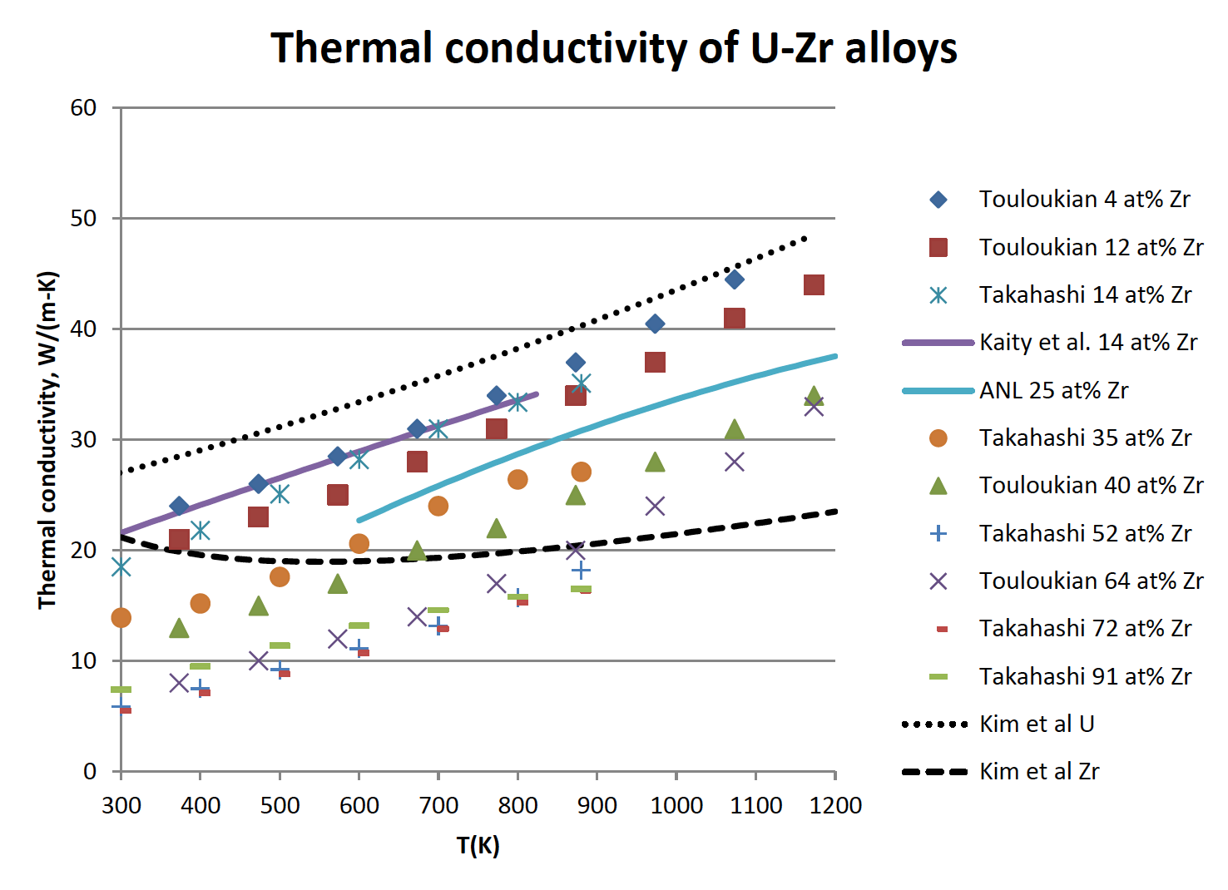
Changes in Thermal Conductivity
U-Zr has a very high thermal conductivity compared to oxide fuels
However, developing porosity will degrade the thermal conductivity
Understanding the temperature also governs how the porosity will develop and how redistribution will vary axially
This is a coupled problem that is complex, but critical for prediction of fuel evolution

Slide 7
Changes in Thermal Conductivity
Bond sodium plays an important role on the thermal behavior of the fuel during irradiation
At the point where the fuel reaches its maximum swelling the porosity in most of the fuel interconnects and gas is vented to the plenum
This allows the bond sodium to infiltrate the fuel body and increase the fuel’s overall thermal conductivity
Sodium infiltration is known because in PIE, the sodium level above the fuel elements, where the fuel has swelled out to the cladding, is always substantially lower than the total amount of preloaded sodium would indicate
Chemical analysis of irradiated fuel finds this “missing” sodium distributed throughout the fuel pin

Slide 8
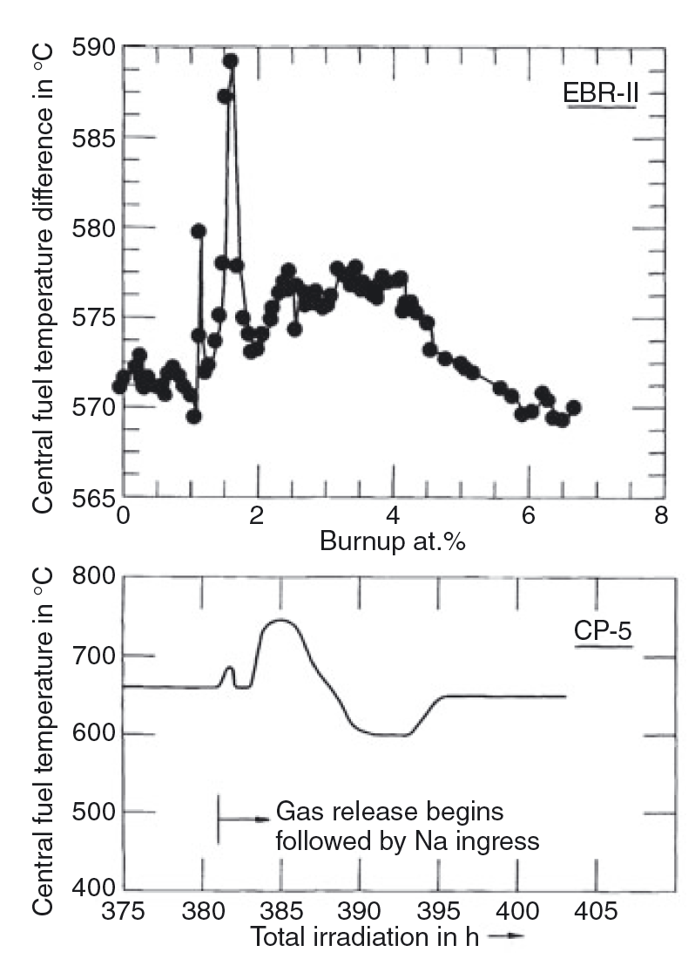
Changes in Thermal Conductivity
On average, approximately 15–20% of the porosity is filled with sodium
The overall thermal conductivity of the fuel drops continuously during the early free-swelling stage, due to porosity development, but then increases rather suddenly with gas release and sodium logging
Experiments at right had thermocouples in the center of the fuel

Slide 9
Fuel-Cladding Interaction
Fuel-Cladding interactions are both mechanical and chemical in nature (FCMI and FCCI)
FCMI results from when the fuel swells, comes into contact with the cladding, and exerts an outward force on the cladding
Early element designs did not allow the fuel sufficient free swelling, this gas bubble pressure was transmitted directly to the cladding
Thus, all early designs suffered from cladding deformation and rupture at modest burnups
This was one of the primary reasons oxide fuels were pursued over metallic alloys
By the time the smear density solution had been implemented, metallic fuels had already been left behind

Slide 10
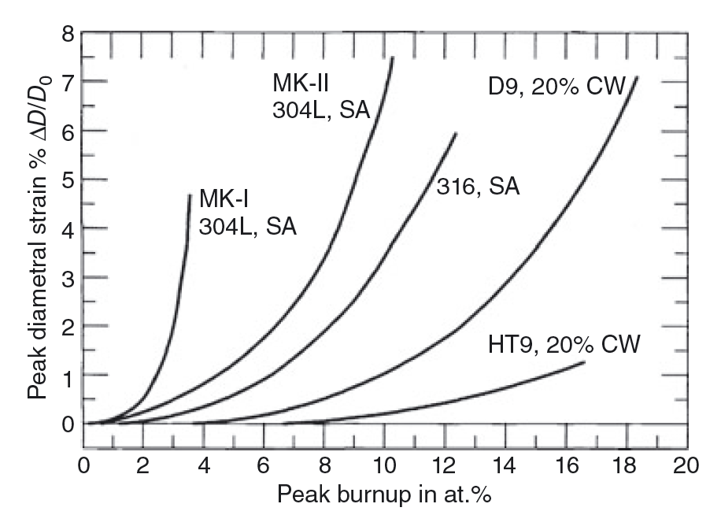
Fuel-Cladding Mechanical Interaction
The cladding strain of high smear density, small plenum fuel rod designs is primarily creep strain due to FCMI (MK-I)
The cladding strain of low smear density, large plenum rods is mainly irradiation-induced cladding swelling (MK-II)
The creep strain can be accounted for by the plenum pressure stress alone, which confirms that FCMI is virtually nonexistent in suitably designed metallic fuel elements
Significant FCMI can be avoided to high burnup if the as-built fuel smeared density is kept to 75%, and a sufficient gas plenum is employed

Slide 11
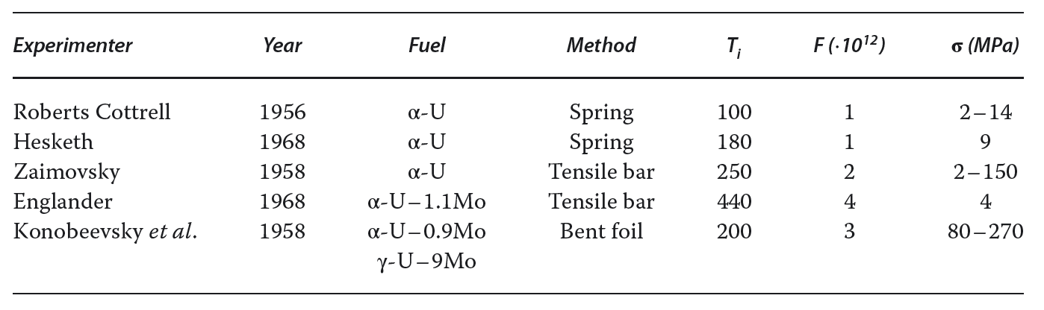
Fission-Induced Creep
Stress in the cladding due to fuel swelling will thus also depend on the effective creep rate of the fuel in-reactor
Measurable creep deformation of α-U during fissioning at temperatures where classical creep does not exist has been experimentally identified
These studies clearly established that at low temperature, the in-reactor creep rate of U is independent of temperature and linearly dependent on both stress and fission rate

Slide 12
Fission Product Swelling
Post-irradiation examinations of high burnup fuel appear largely to support both partitioning into subgroups and assumptions of fission product behavior
A reason for partitioning these fission products is their different migration behavior in the fuel; such grouping allows an evaluation of this migration on the properties of the various radial phasal zones
Zr, Nb, and Mo are all in solution in the fuel phases
Alkali elements (Cs) are dissolved to some extent in the bond sodium
The noble metals (Pt) precipitate as compounds
The rare earths (Nd) precipitate as a separate compound or alloy
The majority of the alkaline (Sr) earths precipitate separately

Slide 13
Fission Product Swelling
The accommodation of the nonsoluble fission products predictably results in a volume expansion as a function of burnup
As U and Pu are removed from the lattice as they fission, this results in a volume decrease that partially offsets the volume expansion due to fission products
Since Zr, Nb and Mo are soluble in the matrix, this compensates for some of the volume decrease due to the disappearance of U and Pu
The result of these contributions is an associated volume increase of 0.2 vol.% per percent burnup

Slide 14
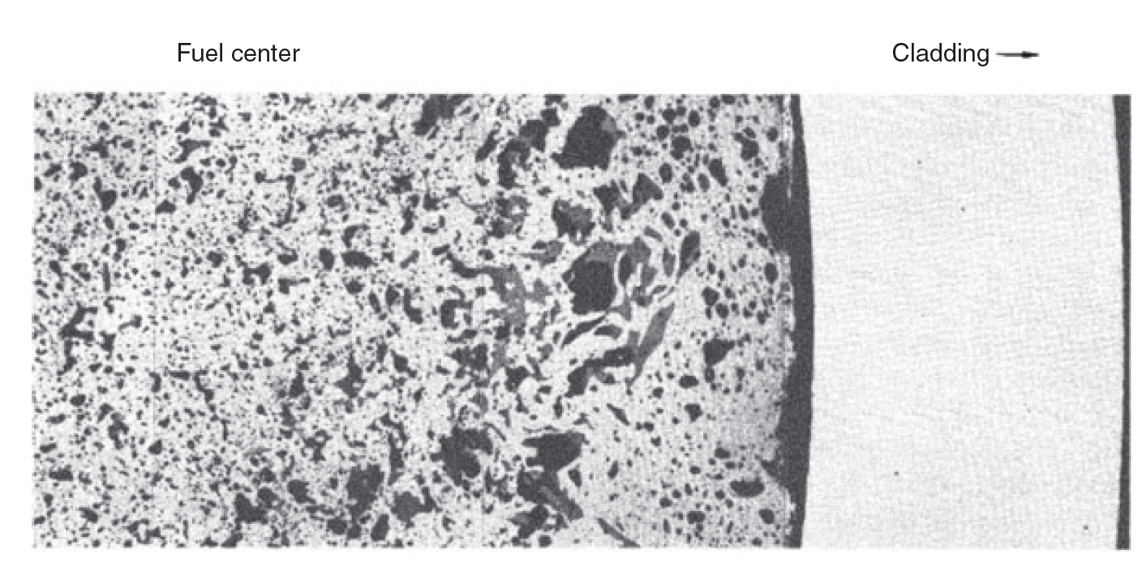
Fission Product Swelling
The rare earths are found to collect in two separate phases in primarily large pores towards the periphery of the fuel and in gaps between the fuel and cladding
A chemical analysis of the bond sodium indicated that a major fraction of the alkali, and also some of the alkaline earth elements, can simply be added to the bond sodium volume

Slide 15
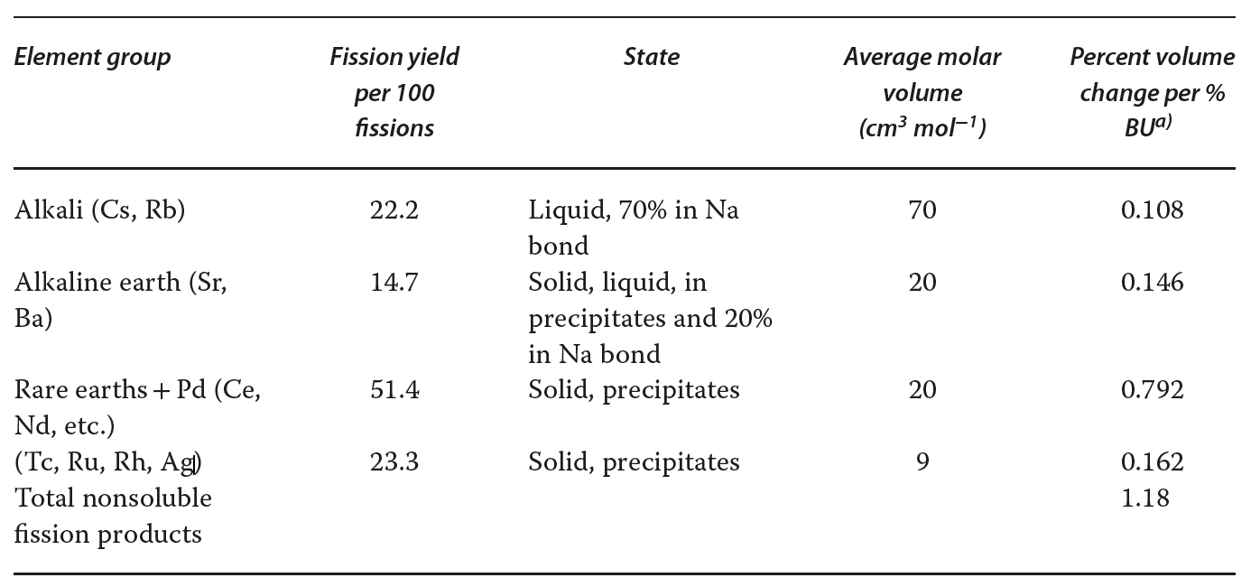
Fission Product Swelling
The total volume of the insoluble fission products amounts to approximately 1.2% fuel volume increase per percent burnup

Slide 16
Fuel-Cladding Chemical Interaction
FCCI is a complex multicomponent diffusion and thermodynamic problem
The characterization of fuel-cladding interdiffusion is exceedingly difficult because of the number of alloy components involved
Fuel element species, minor alloy additions (C, N, O), and fission products all play a role in FCCI
The potential problem of interdiffusion of fuel and cladding components is twofold: (i) a weakening of the cladding’s mechanical properties; and (ii) the formation of relatively low melting point compositions in the fuel
Typically, diffusion couple experiments have been performed to try to evaluate these effects

Slide 17
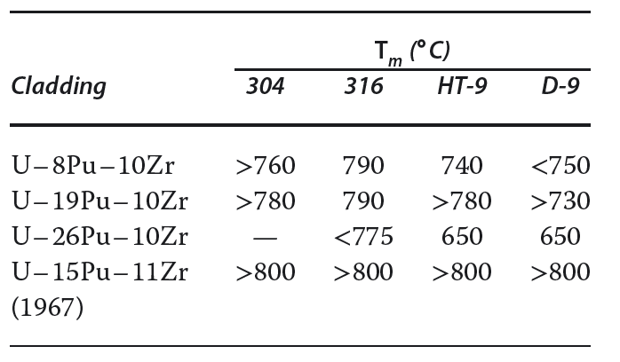
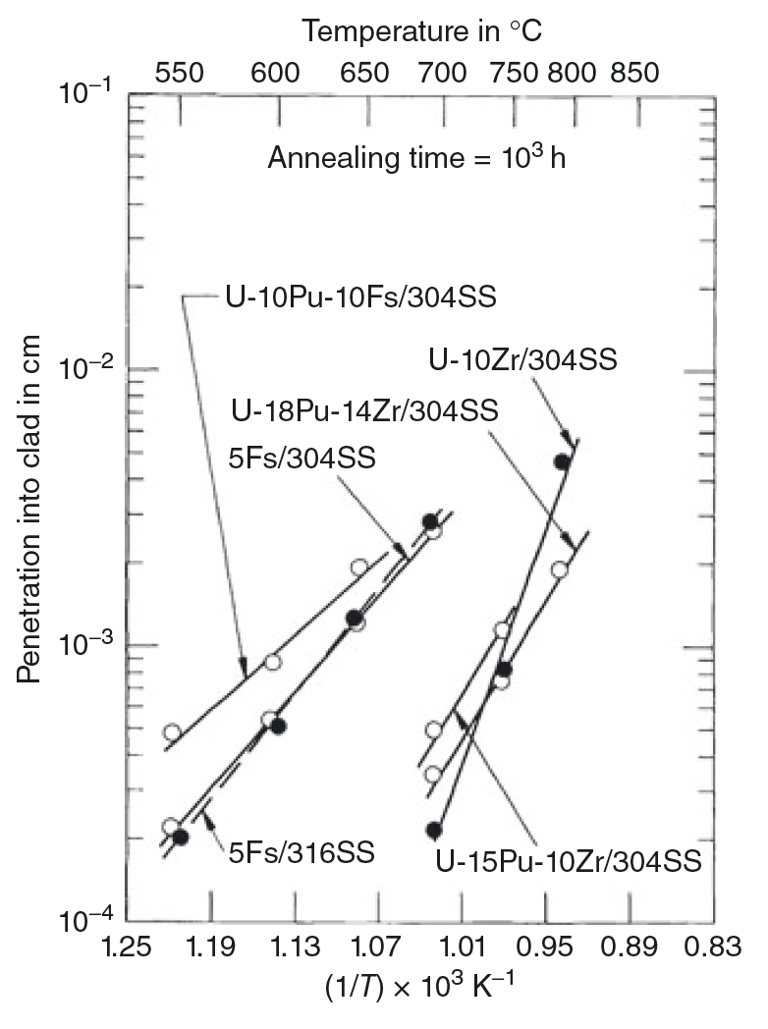
Fuel-Cladding Chemical Interaction
Experiments in the 1960s showed that the addition of Zr showed a decrease in diffusion rates and an increase minimum melting temperature
Thus, Zr diminished the extent of FCCI
Additions of Pu accelerate the rate of attack and low possible melting points
This is one of the bases for which Zr was selected as the alloying element for “modern” metallic fuel

Slide 18
Phase Diagrams for FCCI
To gain initial insight into the phases that may develop at the Fuel/Cladding interface, one can look at available equilibrium phase diagrams, even though the irradiation process deviates from equilibrium
Phase diagrams can indicate the intermetallic phases present, the solid-solubility ranges in different phase regions, and the temperatures and compositions at which liquid phases develop
The intermetallic phases that are present in phase diagrams can form in the interaction zones during the interdiffusion process; wide ranges of solubility in terminal alloys can be an indication that interdiffusion rates may be high; and knowing the compositions of the low-melting phases is beneficial provides knowledge of potentially limiting conditions

Slide 19
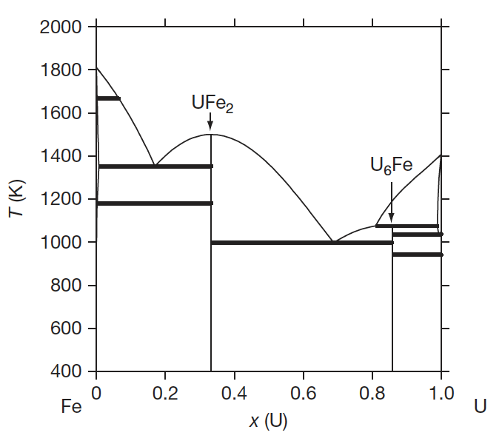
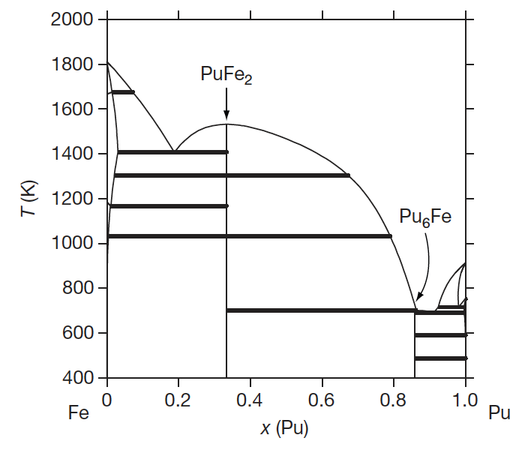
Phase Diagrams for FCCI
The U-Fe and Pu-Fe phase diagrams
Intermetallic UFe2 and U6Fe phases are present in the U–Fe phase diagram and PuFe2 and Pu6Fe phase are present in the Pu–Fe system
These are likely phases to form
These systems also undergo eutectic melting at temperatures as low as ~700K

Slide 20
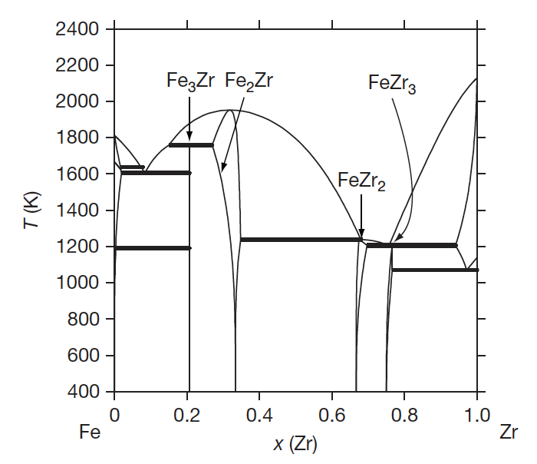
Phase Diagrams for FCCI
Addition of Zr towards U-Fe-Zr and U-Pu-Fe-Zr phase diagrams
Fe3Zr, Fe2Zr, FeZr2, and FeZr3 are intermetallic phases capable of forming in the FCCI zone
Continuous solid solutions have been reported between Pu6Fe and U6Fe and between PuFe2 and UFe2 2: (U,Pu)6Fe and (U, Pu)Fe2

Slide 21
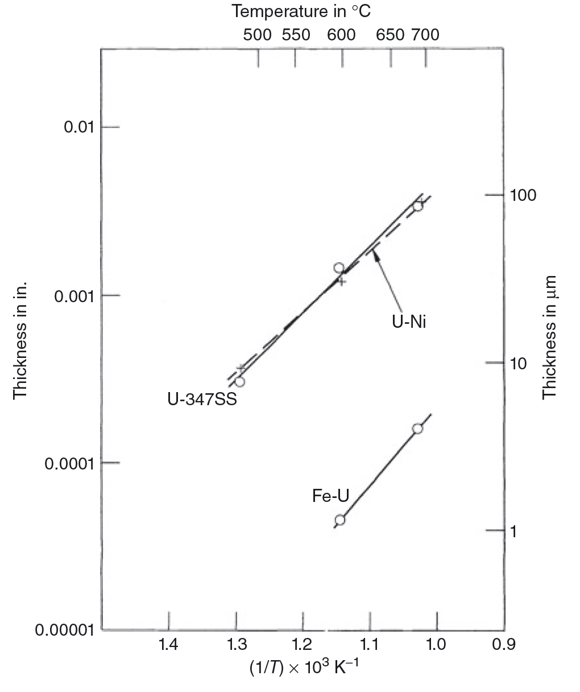
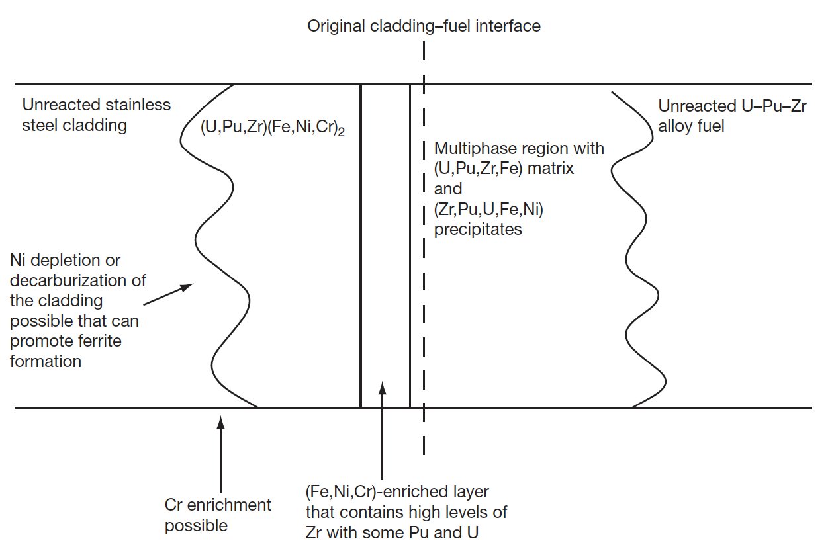
Diffusion Couples
Out-of-pile diffusion couple experiments are typically conducted to determine the interdiffusion behavior of the various constituents at a temperature of interest
Test have been performed with U–Fs, U–Pu–Fs, U–Zr, and U–Pu–Zr and different cladding alloys
Diffusion couple experiments have indicated that a eutectic phase can form in FCCI zones at temperatures near 700C, and this phase is similar to U–Fe6

Slide 22
Protective Rind
Impurities in the fuel or cladding alloys have been suggested to play a role in determining the FCCI behavior
If enough impurities are present (e.g., C, O, or N), then Zr-rich layers that are stabilized by impurities can develop at the interface and impede the interdiffusion process (ZrO2 most likely)
The extent of the formation would depend on the oxygen activity in the cladding
Work has been performed on U–Zr alloys to investigate the development of nitride layers with a N2 cover gas
This has been related to the rind and rind interactions with FCCI
The rind can form during a casting process due to the atmosphere and crucible/mold
It forms on the exterior of the fuel slug, almost like a coating

Slide 23
FCCI
In many of the analyzed fuel elements, fuel–cladding interaction can be linked to the integrity of the Zr-rind
In the image, arrows indicate areas where rind is no longer intact
Both temperature and power variations along the length of a fuel element appear to impact the amount of fuel–cladding interaction that will occur
The maximum fuel–cladding interaction is observed in the combined high-temperature and high-power region of a fuel element

Slide 24
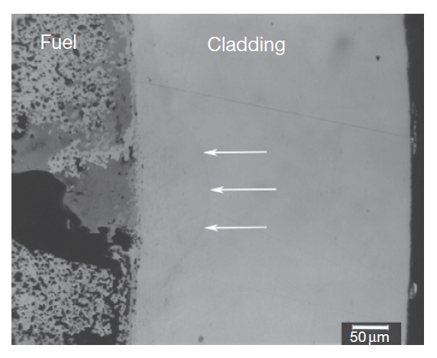
FCCI
The interaction zone formation in irradiated metallic fuel elements is localized
Typically, the largest interaction zones in fuel elements are created when a wedge-shaped crack forms in the fuel adjacent to the inner surface of the cladding and a large fission product deposit (primarily Nd, Ce, and La) develops

Slide 25
FCCI
The burnup of a fuel pin is another parameter that impacts the size of the fuel–cladding interaction zone
Larger interaction zones are observed for higher burnup fuel elements
The larger inventories of fission products allow more lanthanides to diffuse down the temperature gradient, thereby increasing the inventory of fission products at the interface
For high burnup fuels, temperature effects also exacerbate FCCI due to thermal cond. degradation producing higher temperatures, and more rapid FP diffusion
Fuel elements at the hotter core positions can exhibit increased interdiffusion at the fuel–cladding interface over those at colder positions

Slide 26
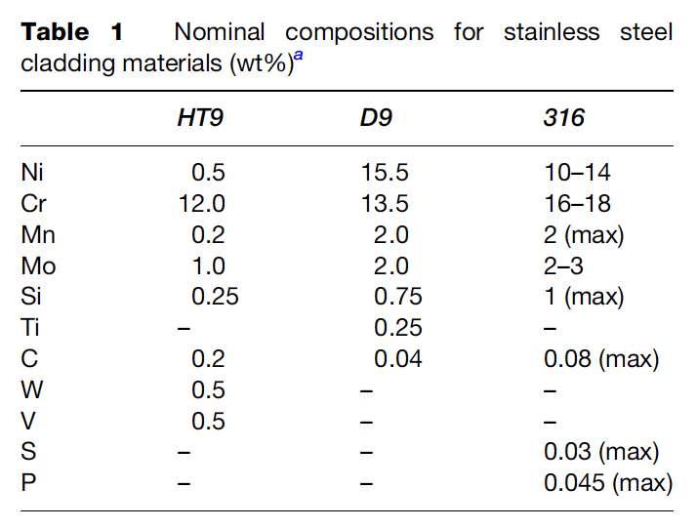
FCCI Compositions
Fe and Cr are the major constituents in HT-9 cladding and should show up as major constituents in the FCCI zones of irradiated HT-9-clad fuel elements
For D9-clad fuel elements, Fe, Ni, and Cr are major constituents that should be present in FCCI zones
There have been some irradiated fuel samples that were specifically destructively analyzed to observe FCCI
The lowest and highest determined temperatures at the fuel–cladding interface were 540 and 660 C, respectively
The thickest interaction zone measured was 170 μm, and the lanthanide fission products were the primary fuel constituents observed in the interaction layers

Slide 27
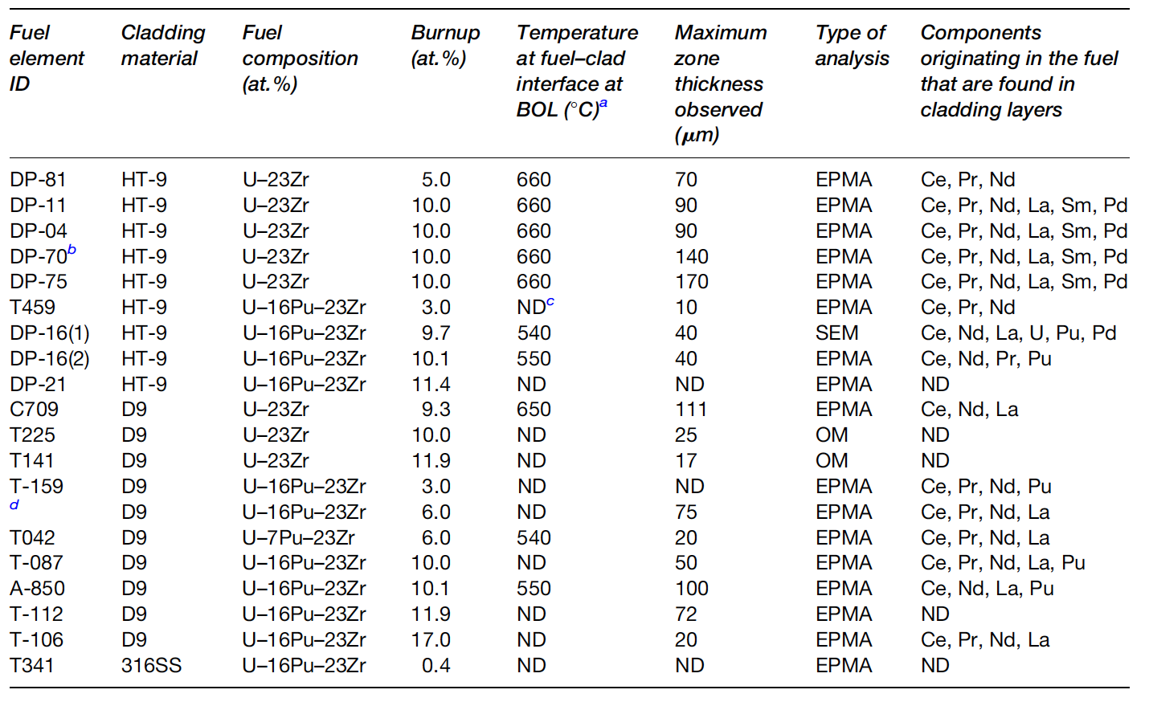
FCCI Examinations

Slide 28
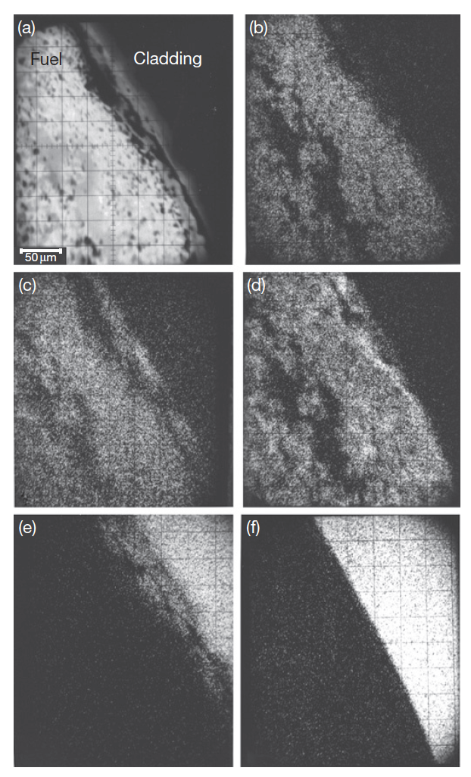
FCCI Compositions
Element DP-16 was the only fuel element in which a sample was generated for analysis using SEM/EDS, in addition to the more typical OM and EPMA analyses usually performed on fuel elements
U-16Pu-23Zr and HT-9 cladding
X-ray analysis maps at the right
(b) U, (c) Pu, (d) Zr, (e) Fe, (f) Cr

Slide 29
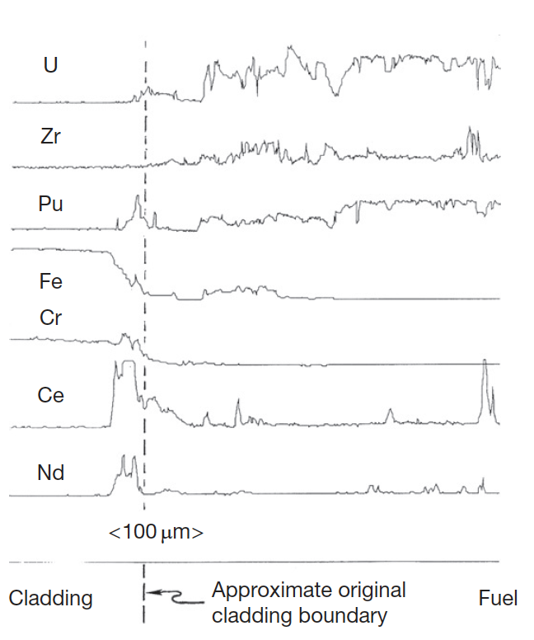
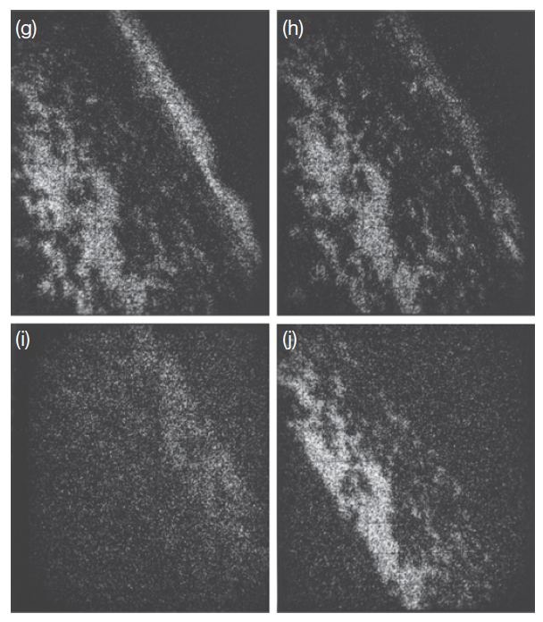
FCCI Compositions
X-ray map for fission products
EPMA analysis for key species
Fe diffuses into the fuel, Ce and Nd diffuse into the cladding, and Pd enriches in localized areas of the fuel near the fuel–cladding interface
The lanthanides penetrated the farthest into the cladding (40 μm) of any components originating in the fuel
(g) Ce, (h) Nd, (i) Ru, and (j) Pd

Slide 30
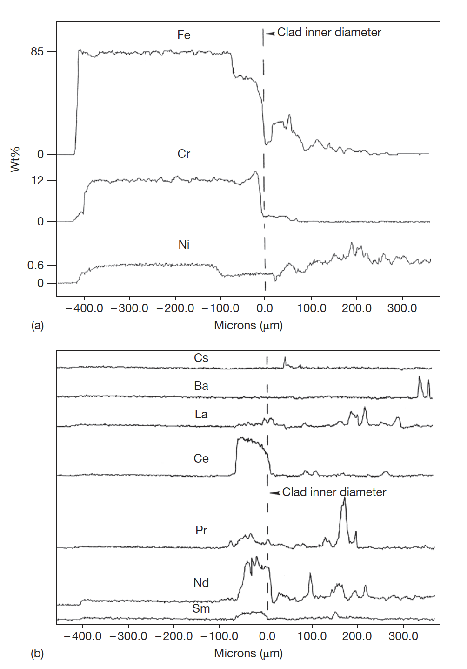
FCCI Compositions
The DP-11 fuel element was irradiated to about 10 at.% burnup at higher cladding temperatures (630–660 C), binary U-Zr
There is a 50-μm-wide zone of the cladding that is high in Cr and low in Fe and Ni
Fe has diffused around 250 μm into the fuel
In the cladding band containing high Cr and low Fe and Ni, lanthanide concentrations are elevated

Slide 31
FCCI
A variety of phases have been observed to form locally where swelled fuel has contacted the cladding
At the interface between the fuel and the cladding, the observed phases on both sides combine the cladding elements Fe, Ni, and Cr with the fuel components U, Zr, and Pu and the lanthanide fission products
In the cladding, the developed phases are enriched with cladding components, and they contain differing amounts of the primary fuel components and fission product components
Lanthanides penetrate farthest into the cladding, specifically Ce and Nd
Fe and Ni depletion zones are observed in all the fuel elements

Slide 32
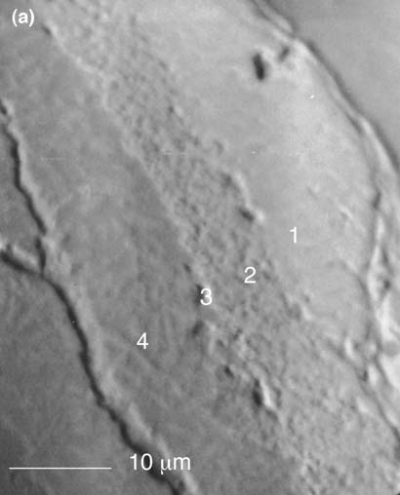
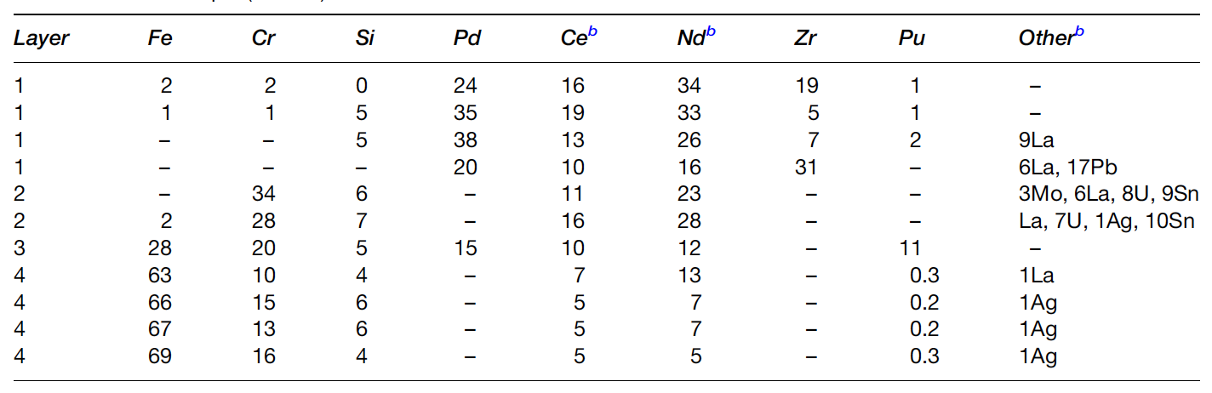
FCCI
In the fuel, some phases are observed that are enriched with the fuel constituents and contain Fe or Ni as the major nonfuel or components
Other phases are observed that primarily contain lanthanides
The interaction zone formation is localized
Other phases form on the cladding side, often a (Fe,Cr)17(Nd,Ce,La)2 type phase

Slide 33
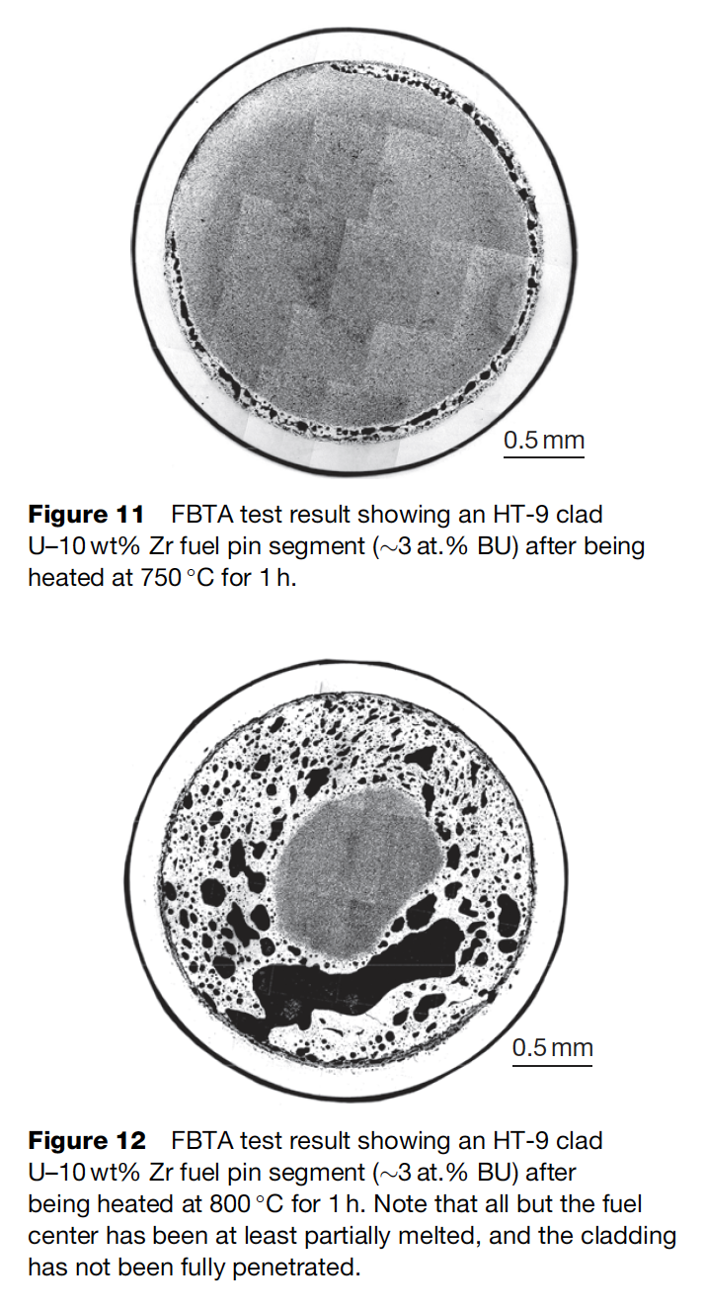
Melting Experiments
One potentially significant impact that the presence of FCCI zones is the melting of phases inside the cladding
This will limit the allowable coolant temperature that can be used for the reactor, and can become more important when considering transients and accidents
This illustrates the effect of the relatively low quantities of Fe required to cause melting on the uranium-rich side of the U–Fe phase diagram
In general, no liquid phase formation is observed below heating at 700C

Slide 34
Questions?

